Slide 1
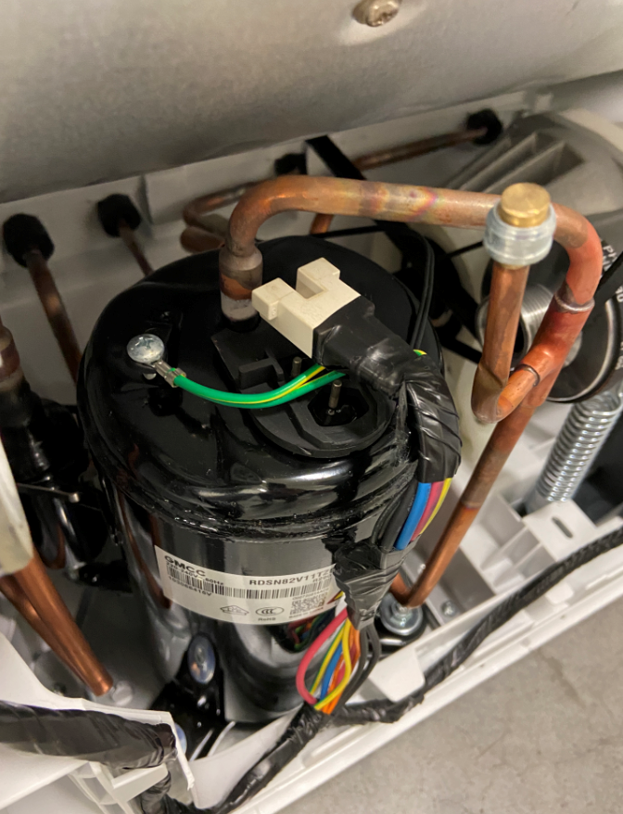
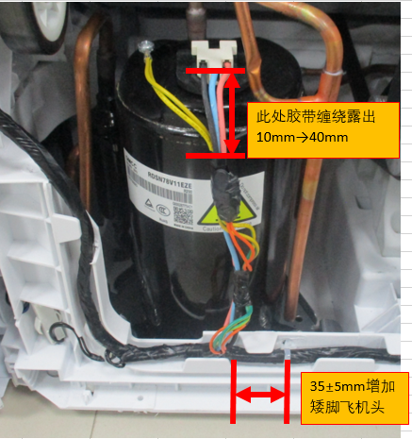
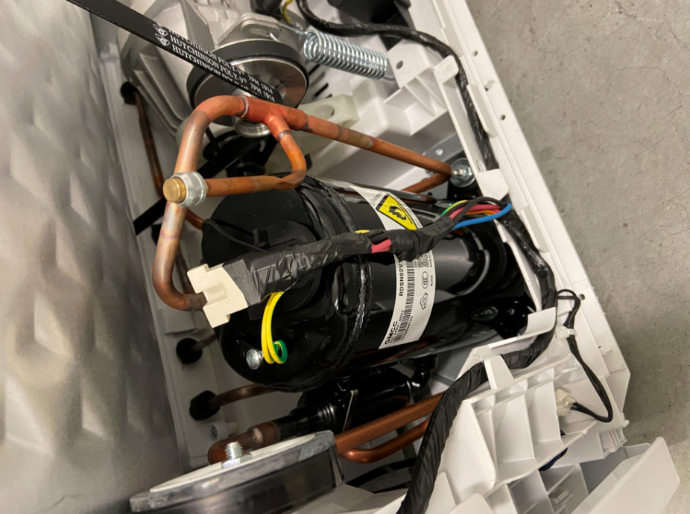
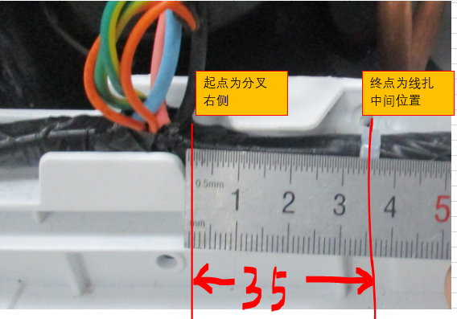
Compressor terminals fall off
Problem description.
Cause Analysis.
Corrective measures.
Customer: Elon
Customer Model: CTT7800V
Whole machine code: 22038220000592
Problem: The compressor terminal of heat pump dryer fell off
1、the wire can not guarantee the installation to the wire slot, resulting in the compressor lead section wire length can not be controlled.
1. Increase the aircraft head at the right 35±5mm at the split of the compressor harness. Completion date: September 19, 2021
2、The compressor terminal head harness is wrapped with tape, forming a lever that pries the compressor terminal up during transport.
2. 40mm left at the compressor terminal tape winding. completion date: September 19

